Slide 1
Data Analysis on
Historical Weather Data
Group Zeus
CHAN, Chun Hin (20853893, chchanec@connect.ust.hk)
CHAN, Long Ki (20774516, lkchanar@connect.ust.hk)
CHUNG, Lok Wang (20852241, lwchung@connect.ust.hk)

Slide 2
Demo Video Link

Slide 3
Demo Video Link
The YouTube video link of our 5-minute video is as shown below:
https://youtu.be/FonI2BFH_Xw

Slide 4
Background & Aim

Slide 5
Background
Climate change is a serious problem in current century
Global average temperature increasing
More frequency natural disasters
Historical weather data is useful for analyzing climate change
Obtain the weather data from different locations around the world
Analyze the climate patterns

Slide 6
Aim
Investigate the weather data in the recent years
Analyze the weather patterns around the world
Build a machine learning pipeline to do prediction on the weather data

Slide 7
Tools & Setting

Slide 8
Google Colaboratory
an online platform to develop and run Jupyter Notebook
Setting:
RAM: 12.7 GB
ROM: 107.7 GB
CPU: Intel(R) Xeon(R) CPU @ 2.20GHz

Slide 9
PySpark
Provides different APIs for:
managing the RDDs
analyzing the dataset
creating machine learning pipelines for various regression tasks
Setting:
Version: 3.5.1

Slide 10
Introduction

Slide 11
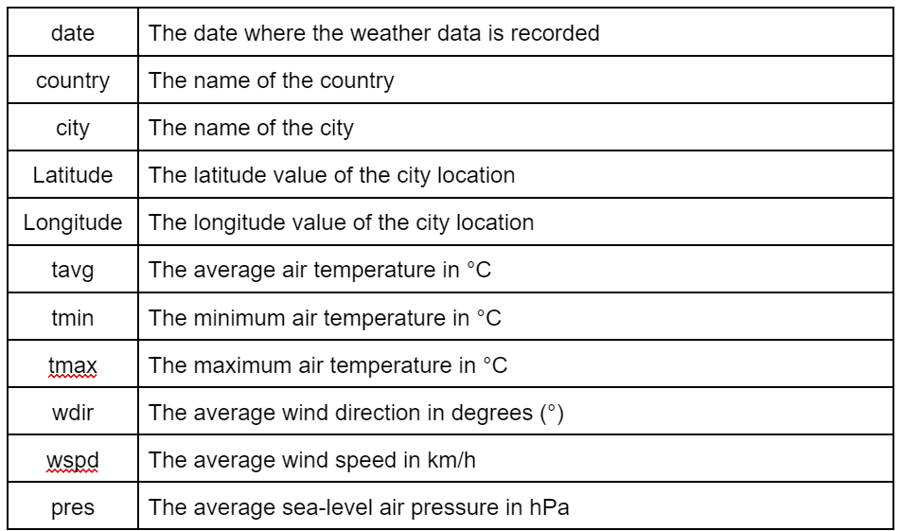
Dataset
Source: https://www.kaggle.com/datasets/balabaskar/historical-weather-data-of-all-country-capitals
324647 rows of weather data
11 columns:

Slide 12
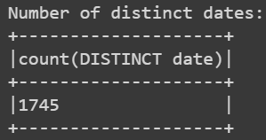
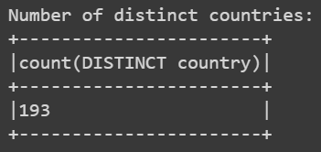
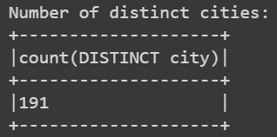
Dataset
1745 distinct dates
193 distinct countries
191 distinct cities

Slide 13
Data Cleaning/Preprocessing

Slide 14
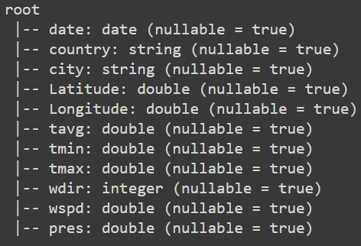
Data Preprocessing
Convert the data type of some of the columns in the dataset
string -> date: “date”
string -> integer: “wdir”
string -> double: “Latitude”, “Longitude”, “tavg”, “tmin”, “tmax”, “wspd”, “pres”

Slide 15
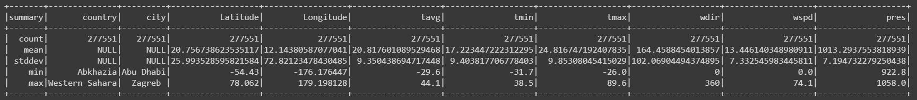
Data Cleaning
Remove the rows of data that contains any NULL values in any column
277551 rows of data remained after data cleaning

Slide 16
Frequency of Typhoons
in Tropical Regions

Slide 17
Frequency of Typhoons in Tropical Regions
Characteristics of typhoon:
uncommonly high wind speed on a certain date
uncommonly low sea-level air pressure on a certain date
Selected Hong Kong and Fiji as the tropical countries/cities
Definition of typhoon(s) possibly occurred on a certain date:
wspd: >= 1.5 times the standard deviation greater than the mean of wspd
pres: <=1.5 times the standard deviation smaller than the mean of pres

Slide 18
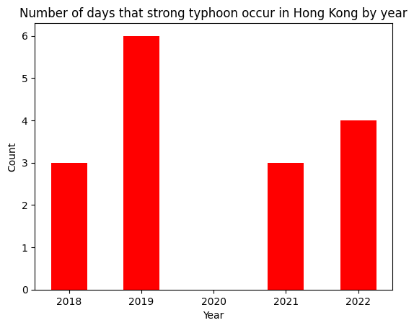
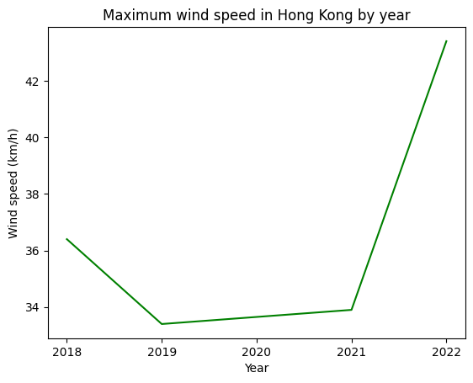
Frequency of Typhoons in Tropical Regions
Hong Kong:

Slide 19
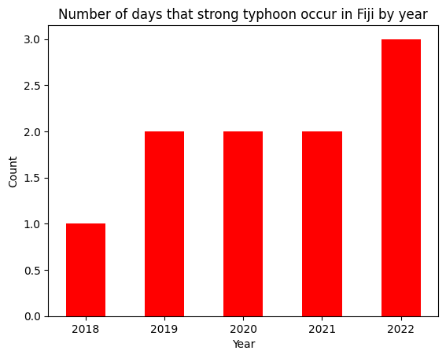
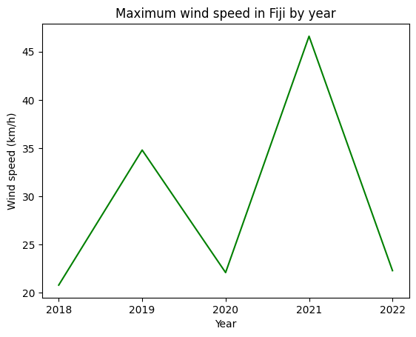
Frequency of Typhoons in Tropical Regions
Fiji:

Slide 20
Frequency of Typhoons in Tropical Regions
Key observations:
Hong Kong: number of days that strong typhoons occur is mostly at least 3 days per year
Hong Kong: an overall increase in the maximum wind speed throughout 2018 to 2022, meaning a stronger typhoon in recent years
Fiji: number of days that strong typhoons that occur is no more than 3 days per year
Fiji: an overall increase in the number of days the strong typhoon occur
Fiji: even though the maximum wind speed in each year alternate each year, this still shows an overall increase in the maximum wind speed, meaning a stronger typhoon in recent years
Short summary: intensity of the typhoon is becoming stronger and stronger.

Slide 21
Global Warming

Slide 22
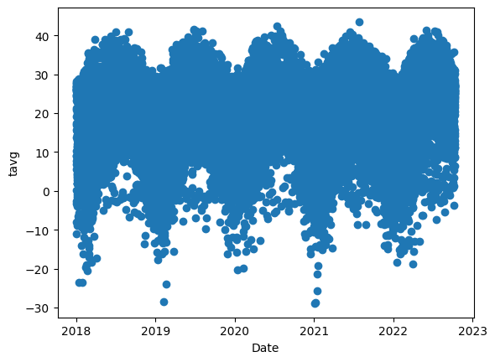
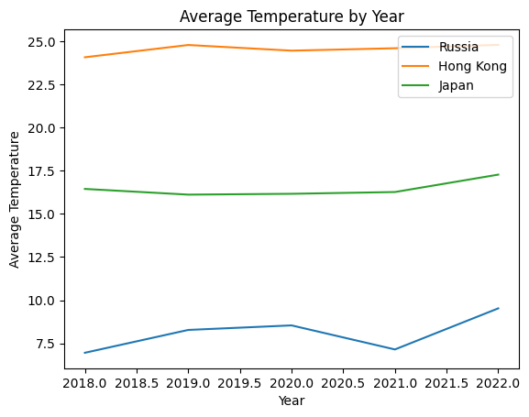
Global warming
Scatter graph of tavg of different time, not intuitive
Changes to line chart of some selected places, did show increase in temperature, but..

Slide 23
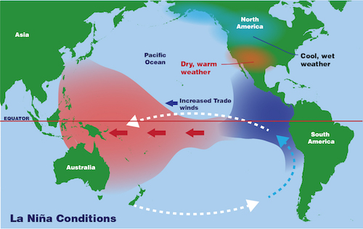
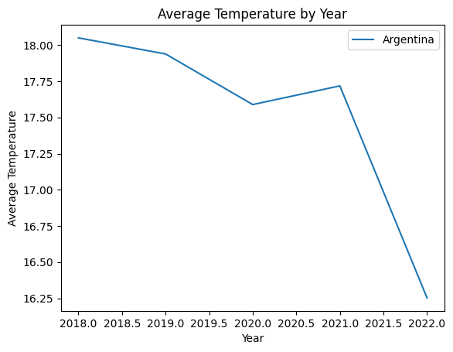
Global warming may not be the major reason for the previous countries
La Niña cause a colder eastern Pacific and a warmer western Pacific

Slide 24
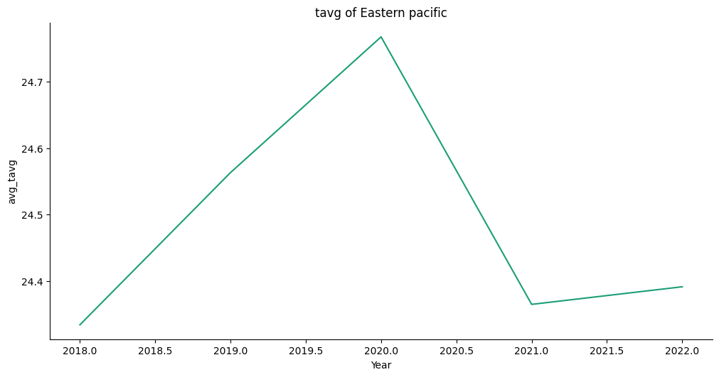
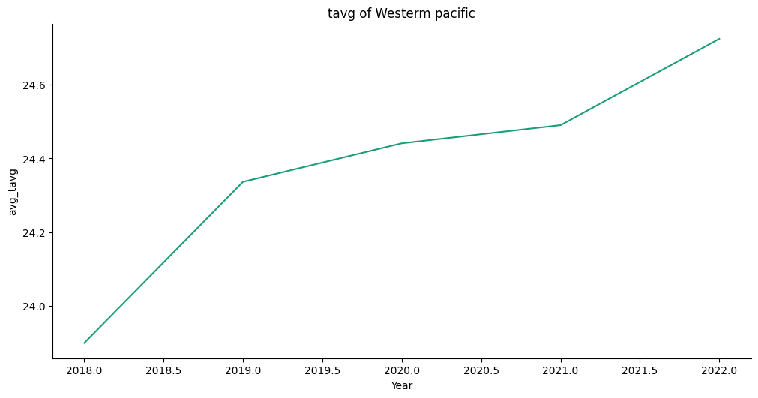
La Niña cause a colder eastern Pacific and a warmer western Pacific
happened in 2020-2022
The opposite event, El Niño happened during 2018-2019
Eastern pacific follow the La Niña and El Niño
Western pacific area temperature keep increase

Slide 25
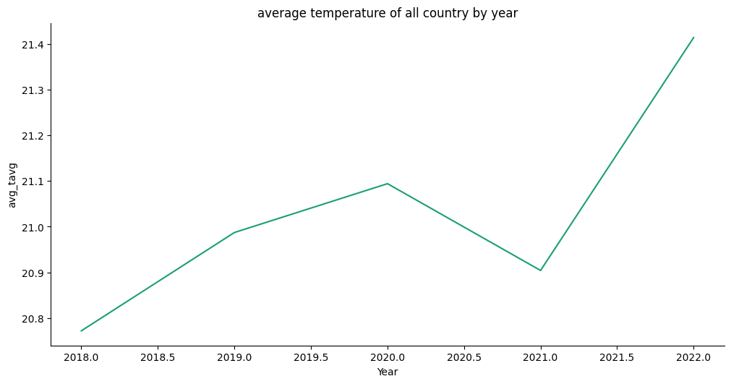
Overall, the temperature keep increase

Slide 26
Linear Regression & Random Forest for Temperature Prediction

Slide 27
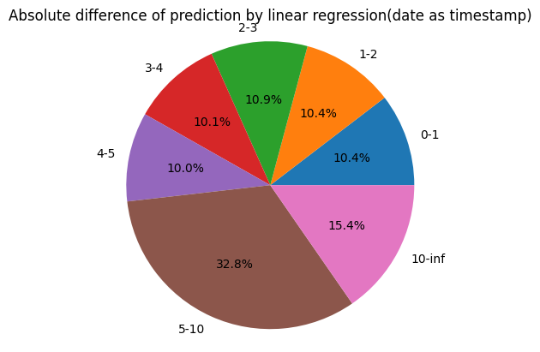
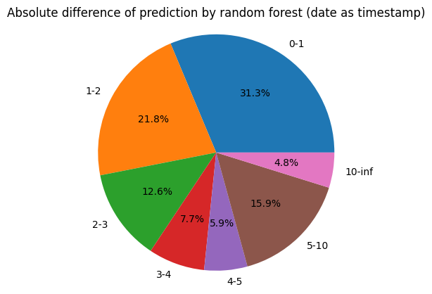
Regression problem on predicting temperature
Feature column: ["Latitude", "Longitude", "wdir", "wspd", "pres", "date"]
Using timestamp to convert date column
User float to convert other columns
RMSE:8.03(linear regression)4.46(random forest)

Slide 28
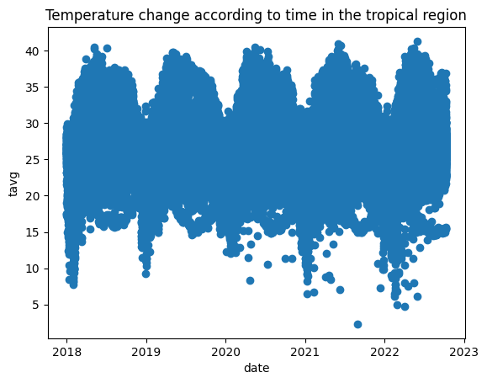
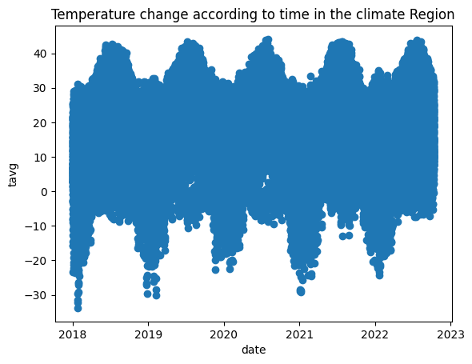
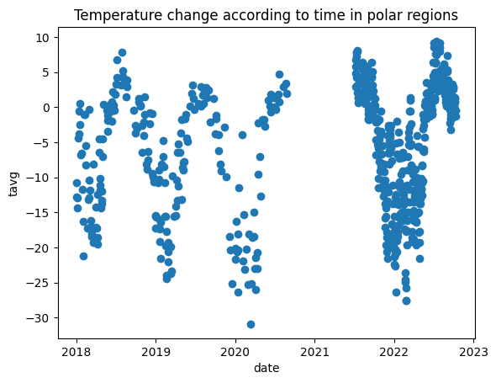
The temperature not heavily dependent on year but on month

Slide 29
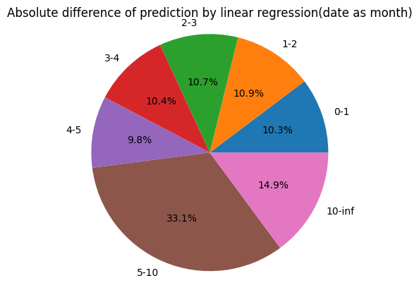
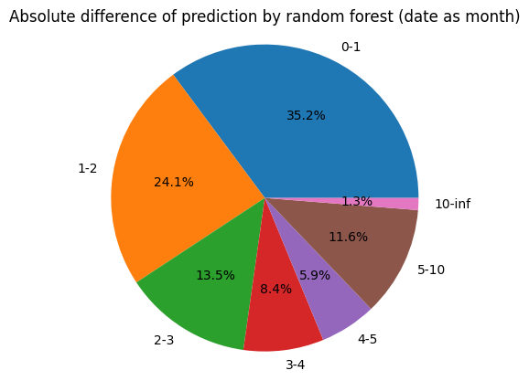
Use month of the date to encode the date column
RMSE:7.99(linear regression)3.35(random forest)
Getting lower RMSE score
The change of percentage of absolute difference of (0-3)
0.2% increase in linear regression
7.1% increase in random forest

Slide 30
Extreme Weather

Slide 31
Extreme Weather
Features:
Severe weather or climate conditions
Unusual
Devastating impact on society
Caused by climate change
Our Analysis:
Extremely hot weather (Heat Waves)
Extremely cold weather (Cold Waves)
Studied Greenland and Russia in Polar Region
Studied India and Burkina Faso in Tropical Region

Slide 32
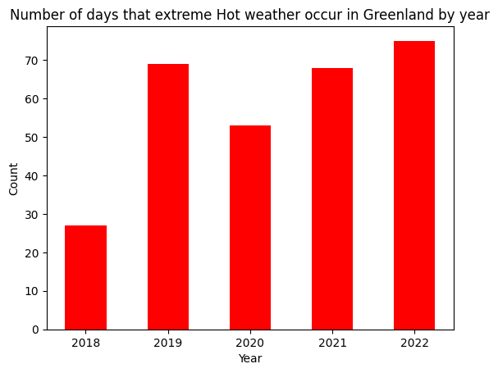
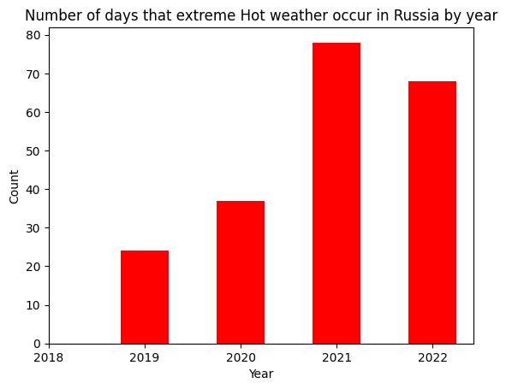
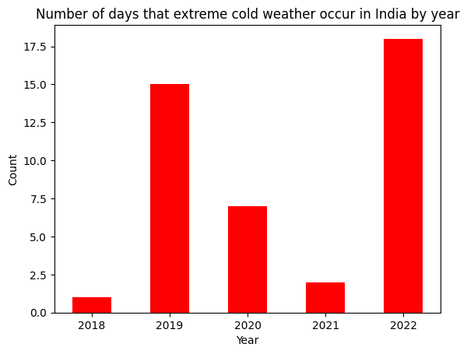
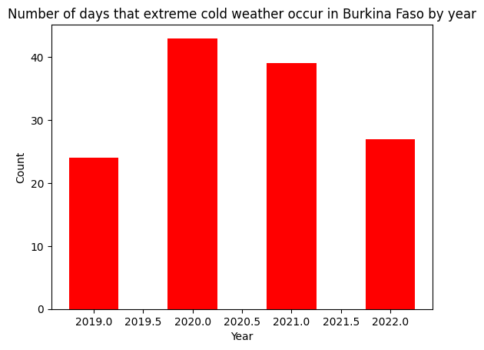
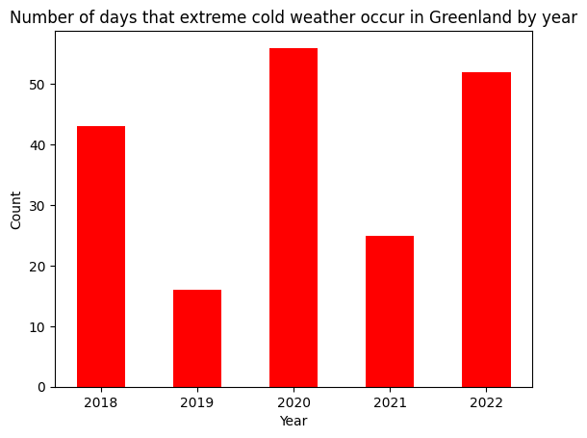
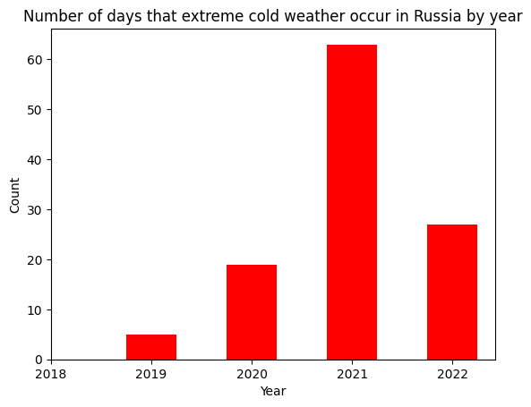
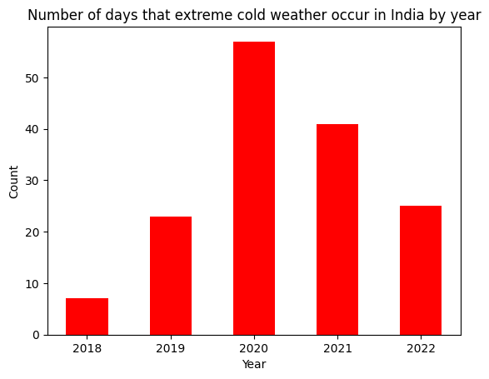
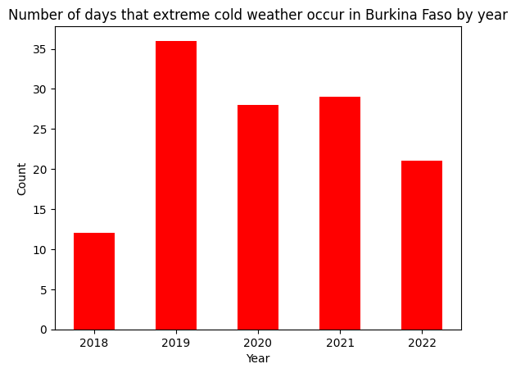
Occurrence of Extreme Weather
The increase in the number of days that extreme hot/cold weather has suggested that heat waves and cold waves are more frequent and occur for a longer period

Slide 33
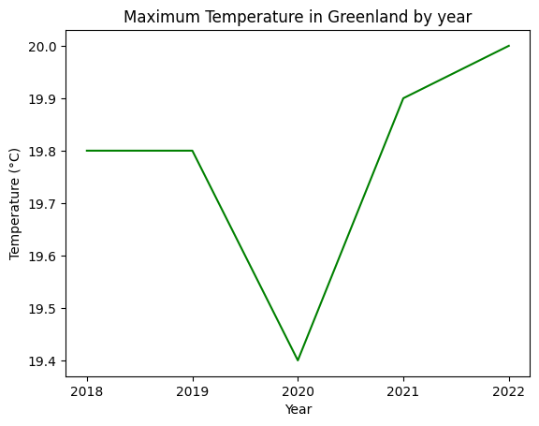
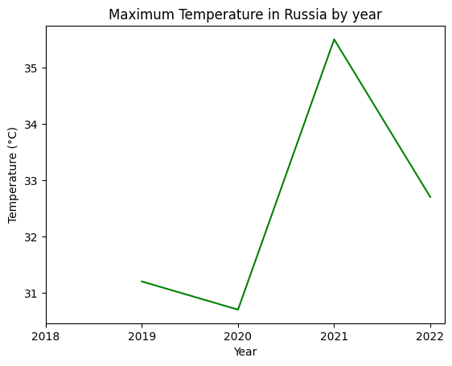
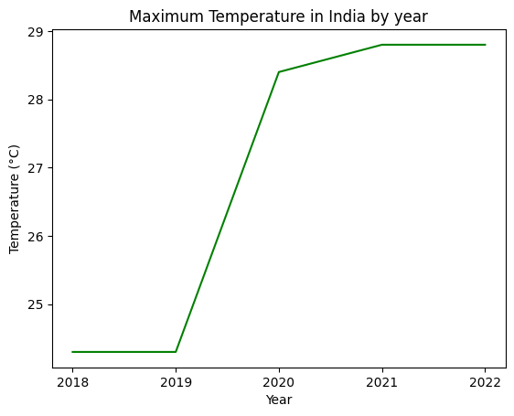
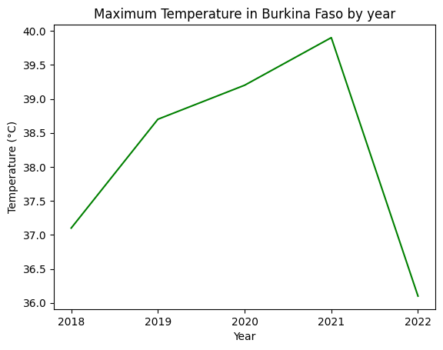
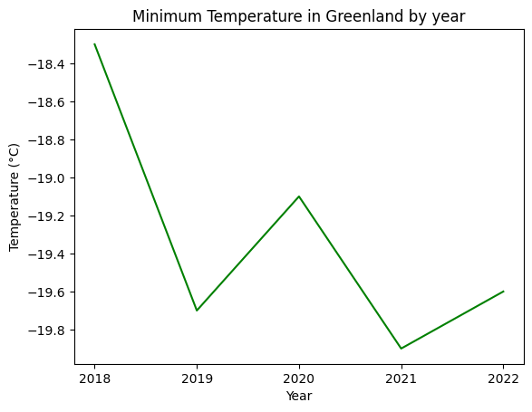
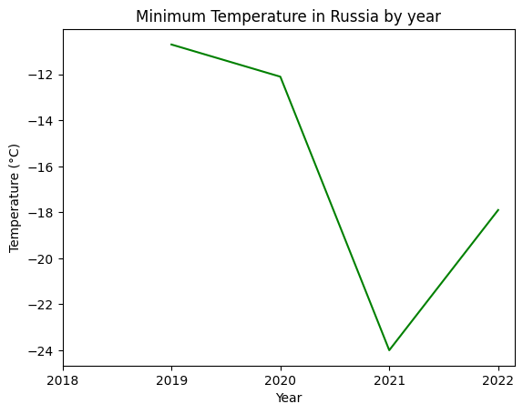
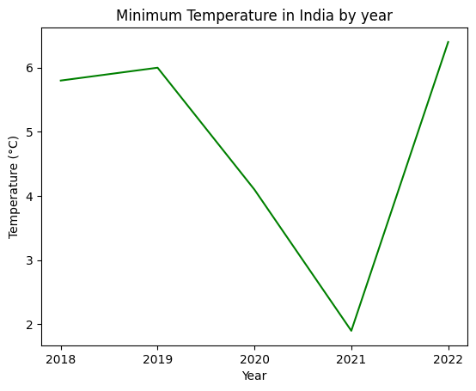
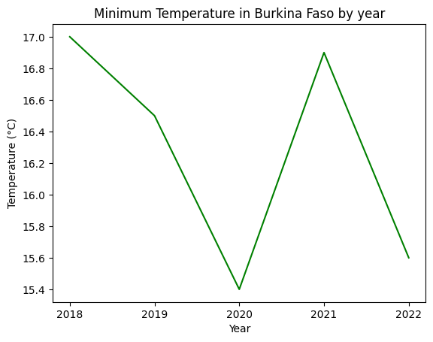
Trend of Extreme Weather Temperature
The increase in maximum temperatures in both Polar Countries and Tropical Countries has shown that extreme heat weather has higher and higher temperatures.
The decreasing minimum temperatures in both Polar Countries and Tropical Countries have also shown that we are having much colder temperatures in extreme cold weather.

Slide 34
Reference

Slide 35
Reference
[1]http://www.bom.gov.au/climate/enso/#tabs=Pacific-Ocean&pacific=History&enso-impacts=La-Ni%C3%B1a-impacts

Slide 36
The End

